Slide 1
Movie Recommender
Group member： Zhengqi Dong, Yuntian He
Email: {dong.760, he.1773}@osu.edu

Slide 2
Background

Slide 3
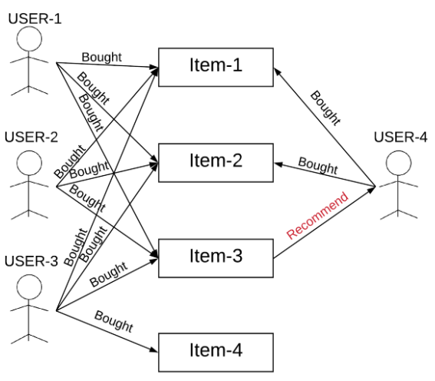
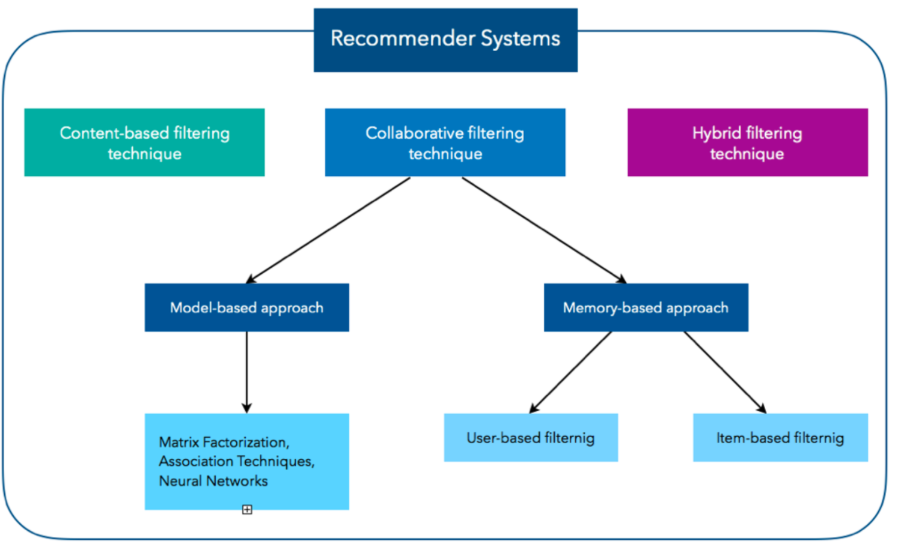
Type of Recommender Systems
Recommender System:
“A recommender system is an information filtering system that seeks to predicts the “rating” or “preference” a user would give to an item.”
Type of Recommender Systems:
Content-Based Filtering
Collaborative Filtering(CF)
Memory-Based Collaborative Filtering, e.g., User-based CF, Item-based CF
Model-Based Collaborative Filtering, e.g., Matric factorization, Neural Network
Hybrid Filtering
Courtesy: 1) https://d2l.ai/chapter_recommender-systems/recsys-intro.html 2) https://dl.acm.org/doi/pdf/10.1155/2009/421425 3) https://arxiv.org/pdf/1707.07435.pdf, 4) https://humboldt-wi.github.io/blog/research/applied_predictive_modeling_19/causalrecommendersystem/
Notes:
A recommender system is an information filtering system that seeks to predicts the rating given by a user to an item. The type of recommender system can be categorized to three types: 1)… 2)…3)…
Content-based filtering: The Content-Based Recommender relies on the similarity of the items being recommended (and sometime it’s also known as the similarity-based filtering). The basic idea is that if you like an item, then you will also like a “similar” item. But, in order to define the similar items, you first need a way to define the similarity between the item or users. But, since that’s not the focus of our project, so I won’t go into too much detail about that.
The collaborative filtering is based on the idea that, the user who have agreed in the past tend to also agree in the future. For example, to the picture at the right, we see the User-4 bought Iterm-1 and Iterm-2, in the meantime, we observed that all three users (User1-3) agreed the Item-3 is worth purchasing in the past, then it’s likely that the Item-3 is something worth for the User-4 to purchase as well.
A Hybrid filtering algorithms combines the CF with other recommendation techniques, which is the type of recommender system we will present today!
idea: The content-based recommender relies on the similarity of the items being recommended. For example, if you like an item, then there is higher change you will like a “similar” item under the same categories.
There are two way to obtain the information from user, explicit and implicit extraction. Explicit extraction is directly asking user questions. Implicit extraction is based on unspoken data, such as users' profiles, a set of actions on browser session.
Reference:
https://www.sciencedirect.com/science/article/pii/S1110866515000341#:~:text=Recommender%20system%20has%20the%20ability,online%20shopping%20environment%20%5B4%5D.

Slide 4
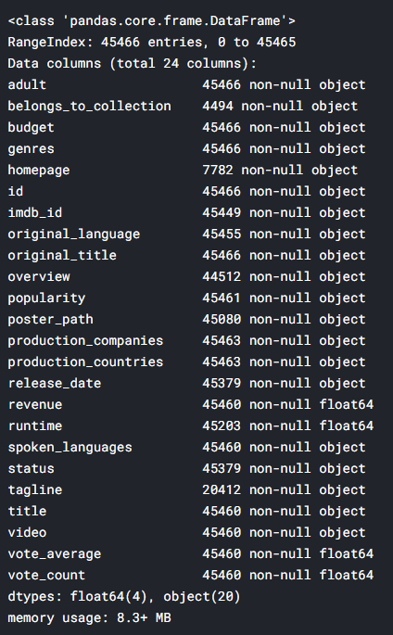
Dataset description
The Movies Dataset from Kaggle
26M ratings from 270K users on 45K movies
Content
Text: Each movie has an overview (a paragraph)
Rating: A tuple (UserID, MovieID, Rating, Timestamp)
Other Attributes:
Genre: e.g. Action, Animation, Romance, …
Credits: (cast, crew)
* https://www.kaggle.com/rounakbanik/the-movies-dataset
Notes:
The movie dataset is token from Kaggle, and is originally released by MovieLens website, which is a project run by GroupLens, it’s a research lab at the University of Minnesota.
And, here is some feature about the dataset. This dataset had abundant features as you can see in the figure. But, here is couple features that we considered to use：
Text: an overview for the movie
Rating is constituted by 4 elements, UsrID, movieID, rating(an integer scaled from 1-5), and timestamp
Some other attributed include genre and credits

Slide 5
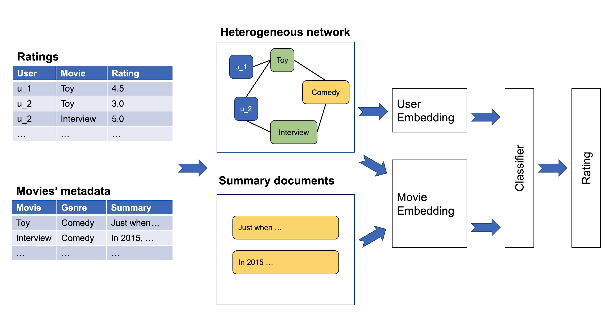
System framework
Graph embedding
Classifier
Text embedding

Slide 6
Preprocessing
Removing data in incorrect format
3 of 45K movies are deleted
Index adjustment
Consecutive IDs for convenience
Attribute selection
Cast: Only top 8 casts (cast order included in the raw data)
Crew: Only use ‘director’

Slide 7
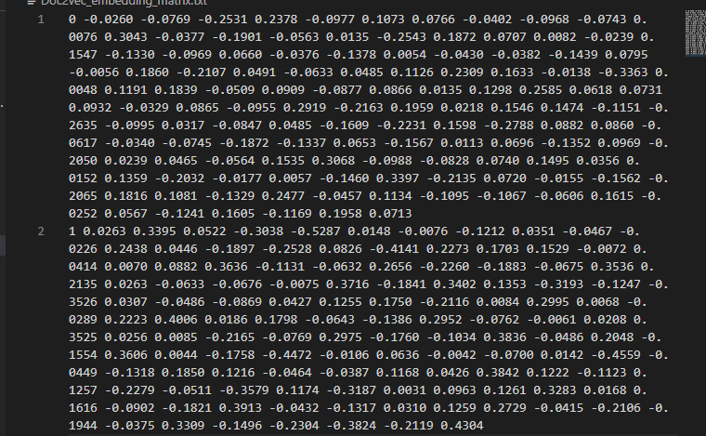
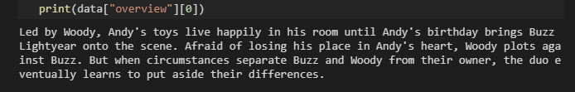
Text Embedding: Doc2vec
Goal: Use Doc2Vec to learning the main content of movies’ metadata, and represent it as an e_{mt,} 128 dimensional vector for each movie. (subscript mt is for movie text embedding, and mg is for movie graph embedding)
Reason why we used Doc2Vec
It can learn vector representation from unlabeled data and generalized well on the data that do not have enough labels.
Dov2vec takes word orders into consideration while learning the semantic meaning of documents.
Implementation:
Use gensim package to
movie’s overview ➔ embedding vectors
Notes:
There are a lot of metadata related to movie, such as genres type, tags, and movie overview. But the goal here is to learn a representation that can capture or describe the main content of a movie, which related to the idea of content filtering, if a user like an item, he will also like a similar item.
In our case, since the genres and tags are too short to use, so we used movie overview will be generate the text embedding.
Why not use BERT? ➔ Tried, but don’t have enough time to figure out how to use it.
BERT Reference:
Explanation, https://towardsdatascience.com/bert-explained-state-of-the-art-language-model-for-nlp-f8b21a9b6270
Code repo, https://github.com/google-research/bert#fine-tuning-with-bert
Colab--BERT End to End (Fine-tuning + Predicting) with Cloud TPU: Sentence and Sentence-Pair Classification Tasks, https://colab.research.google.com/github/tensorflow/tpu/blob/master/tools/colab/bert_finetuning_with_cloud_tpus.ipynb#scrollTo=0yamCRHcV-nQ
BERT Paper, https://arxiv.org/abs/1810.04805
Attention paper, https://arxiv.org/pdf/1706.03762.pdf

Slide 8
Graph embedding: Metapath2vec
Heterogeneous information network
User (U), Movie (M), Genre (G), Cast/crew (C)
Metapath2vec-based sampling
Preserve semantic relationships between nodes
U-M-U, U-M-G-M-U, U-M-C-M-U
Rating-aware sampling policy
Similarly sample for P(m->u).
Genre
Movie
5
2
5
User
* "metapath2vec: Scalable representation learning for heterogeneous networks." Proceedings of the 23rd ACM SIGKDD international conference on knowledge discovery and data mining. 2017.
Notes:
The previous publication are mainly related to word2vec-based learning network, such as DeepWalk, node2vec. Those network use singular type of node and relationship to constructure the network model, and that’s why it’s called homogeneous network.
But, in our project, there are many type of attribute we want to take into consideration, such as User, movie, genre type, and cast/crew, so the graph embedding is used to capture the internal relations of richer and more complicated data content, as well as the relations amount those objects. Motivated by the success of representation learning of heterogeneous information network, we applied a Metaphath2vec sampling algorithm to produce the graph embedding vectors.
Firstly, a Random walks algorithm, that was previous used in DeepWalk and node2vec those homogeneous network model, was used to make connection amount those nodes, and feeds those sequences of nodes to a skip-gram model to learn nodes embedding. One challenge for directly using those traditional embedding method to our project is the network is heterogeneous, so in order to preserve the proximity between nodes and its neighborhood, we need to find a way to optimize the embedding model while maintaining the structures and semantics of multiple type of nodes and relations. In order to tackle this problem, a novel rating-aware sampling policy is used to ensure the predicted rating score associated with neighboring moves in random walk that are close with high probability.
Goal: maximize the likelihood of preserving both the structure and semantics of a given heterogeneous network.

Slide 9
Classification
Goal:
A 3-layey MLP is used as a classifier for our last module to take the text embedding vector and graph embedding to predict the rating score.
Layer size:
128, 32, 10.
Note: input layer takes 128-dimensional vector, and 32 neurons for hidden layer, and 10 neurons for output layer.
Epochs: 5
Learning rate: 1*10^-3
Computing Environment: OSC Owens cluster with single GPU node
Notes:
The last module is a classifier which takes the learned embeddings of users rating and movies overview in the first two modules as input, and use them to predict a rating score. A common option for the classification module is MLP.

Slide 10
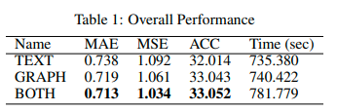
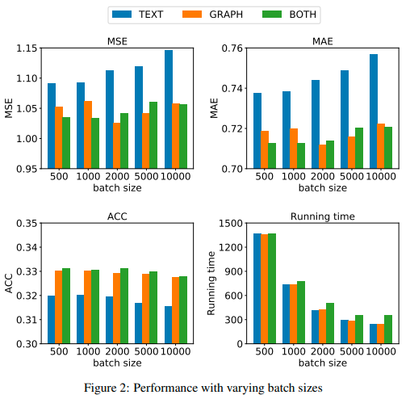
Conclusion
Methods
Use text embedding only (TEXT)
Use graph embedding only (GRAPH)
Use both text and graph embedding (BOTH)
Key Takeaway
BOTH methods outperforms other two in all metrics
BOTH method takes 5.61% longer to train than the other twos on average.
ACC (or MSE/MAE) decrease as batch size increases (or increase)
Training faster as batch size increases
Notes:
Our result is not very good, it only has about 33% ACC, but there are many way we can do to improve the performance, such as replace the Doc2vec with BERT algoirthm to produce a higher quality of text embedding, as well as considering the more matadata to produce the graph embedding, or find-tune the configuration parameter and train a bit longer with larger epoch number, can also increase the performance.
But. Here some key takeaway, that we discover from this project.

Slide 11
Thanks! Any Question?

Slide 12
Reference
[1]Jacob Devlin, Ming-Wei Chang, Kenton Lee, and Kristina Toutanova. Bert: Pre-training of deepbidirectional transformers for language understanding.arXiv preprint arXiv:1810.04805, 2018.
[2]Yuxiao Dong, Nitesh V Chawla, and Ananthram Swami. metapath2vec: Scalable representationlearning for heterogeneous networks. InProceedings of the 23rd ACM SIGKDD internationalconference on knowledge discovery and data mining, pages 135–144, 2017.
[3]Yoon Kim.Convolutional neural networks for sentence classification.arXiv preprintarXiv:1408.5882, 2014.
[4]Quoc Le and Tomas Mikolov. Distributed representations of sentences and documents. InInternational conference on machine learning, pages 1188–1196, 2014.
[5]Francesco Ricci, Lior Rokach, and Bracha Shapira. Introduction to recommender systemshandbook. InRecommender systems handbook, pages 1–35. Springer, 2011.
[6]Xiaoyuan Su and Taghi M Khoshgoftaar. A survey of collaborative filtering techniques.Advancesin artificial intelligence, 2009, 2009.
[7]Shuai Zhang, Lina Yao, Aixin Sun, and Yi Tay. Deep learning based recommender system: Asurvey and new perspectives.ACM Computing Surveys (CSUR), 52(1):1–38, 2019.

Slide 13
Text embedding

Slide 14
Collaborative Filtering:
Based on the similarity of two user: e.g., “The user watched this movie are also like…”
Doesn’t depends on any algorithm but other users' behavior. Dynamic model, information update automatically.
Two main types of memory-based collaborative filtering algorithm:
User-User Collaborative Filtering: Find the look-alike user based on current user favorite movie, and recommend movie based on look-alike user’s history. This algorithm is effective but time consuming to compute the user pair information for a large database.
Iterm-Iterm Collaborative Filtering: Instead of finding look-alike user, we try to find the look-alike movies, the movie have similar categories, tagging, entity, rating and etc. Lett time consuming, especially for a new user.
Courtesy: https://medium.com/datadriveninvestor/how-to-built-a-recommender-system-rs-616c988d64b2
Notes:
The collaborative filtering is based on the idea that, the user who have agreed in the past tend to also agree in the future. For example to the picture at the right, we see the User-4 bought Iterm-1 and Iterm-2, in the meantime, we observed that all three users (User1-3) agreed the Item-3 is worth purchasing in the past, hence we can assume the Item-3 is something worth for the User-4 to purchase as well.

Slide 15
Content-Based Filtering
Idea: The content-based recommender relies on the similarity of the items being recommended. For example, if you like an item, then there is higher change you will like a “similar” item under the same categories.
There are two way to obtain the information from user, explicit and implicit extraction. Explicit extraction is directly asking user questions. Implicit extraction is based on unspoken data, such as users' profiles, a set of actions on browser session.

Slide 16

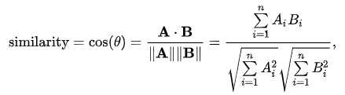

Collaborative Filtering: Jaccard Vs Cosine Vs Pearson
Jaccard similarity: aka Jaccard index, intersection over union
Cosine similarity: The distance(the length of the component of B points in the same direction as A) decrease with the increasing value of angle between A and B
Pearson Similarity: aka Pearson correlation coefficient. Measure the linear correlation between X and Y
Notes:
Courtesy:
Jaccard similarity:
https://en.wikipedia.org/wiki/Jaccard_index
Cosine similarity
https://en.wikipedia.org/wiki/Cosine_similarity
https://masongallo.github.io/machine/learning,/python/2016/07/29/cosine-similarity.html

